Slide 1
Accelerating Scientific Workflows on HPC Platforms with In Situ Processing
Loïc Pottier University of Southern California, School of Engineering
Information Sciences Institute
lpottier@isi.edu

Slide 2
Outline
Context
General Approach
Experimental Setup
Experimental Results
Conclusion

Slide 3
Context

Slide 4
Scientific Workflows
Workflows represented as directed acyclic graphs (DAG)
Workflow management systems (WMS) execute workflows on distributed resources
Vast majority of WMS uses files to communicate between jobs
Set of jobs executed in a given order based on their data dependencies

Slide 5
Why in situ matters
From post-processing to iterative processing
Popular in molecular dynamics for example
Simulations send data every k iterations to some analysis kernels
In situ helps overcome I/O bottlenecks (slow filesystems etc)

Slide 6
Goals
WMSs use file-based I/Os with loosely-coupled jobs (HTC model)
In situ frameworks often rely on in-memory computing
Minimize code modifications of existing workflows
How to integrate in situ technology with traditional WMS?
⇒ job clustering

Slide 7
General Approach

Slide 8
Pegasus and Decaf
Pegasus
Decaf
Workflow management system, runs static DAGs
Well-established WMS (started in 2001)
Relies on HTCondor for its execution back-end
Pegasus relies on files to synchronize jobs
Middleware for building and executing in situ workflows (from ANL)
Producer/consumer model using MPI communicators (point to point)
Multiple-program-multiple- data (MPMD) model

Slide 9
Job Clustering
Users express their computations using the Pegasus API
Job clustering:
Cluster jobs with the pegasus-mpi-cluster (PMC) engine
Users simply annotate the jobs that have to be clustered together
Pegasus automatically infers the correct Decaf/PMC representation and creates the appropriate workflow representation

Slide 10
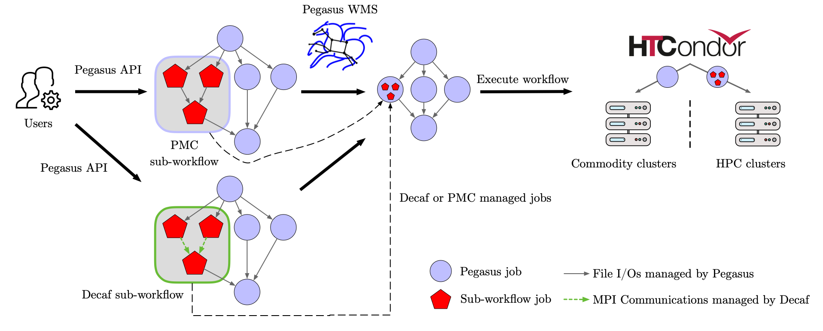
Integration

Slide 11
Experimental Setup

Slide 12
Platform
Cori at National Energy Research Scientific Computing Center (NERSC)
Cray XC40 with:
2 Intel Xeon E5-2698 v3 (16 cores each)
128 GB of DRAM
Cray Aries interconnection network
Only CPU nodes in this work
Pegasus submits to Slurm

Slide 13
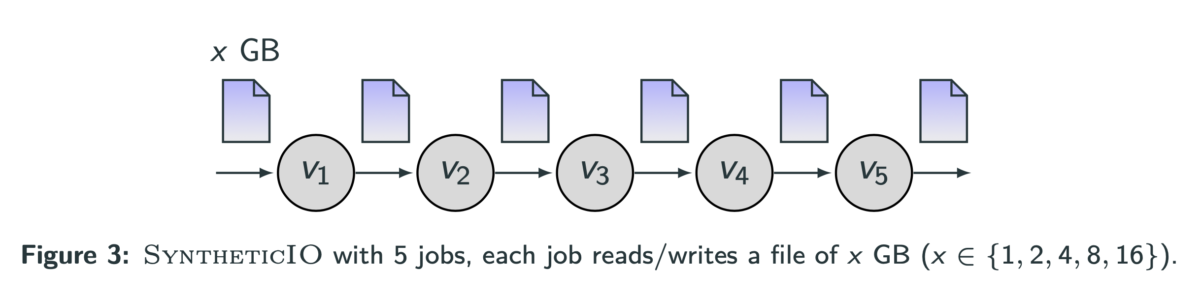
SyntheticIO
Each job reads/writes a file of x GB (x ∈ {1, 2, 4, 8, 16})
Each job sleeps for 2 seconds per GB written
We cluster all jobs together (one cluster)

Slide 14
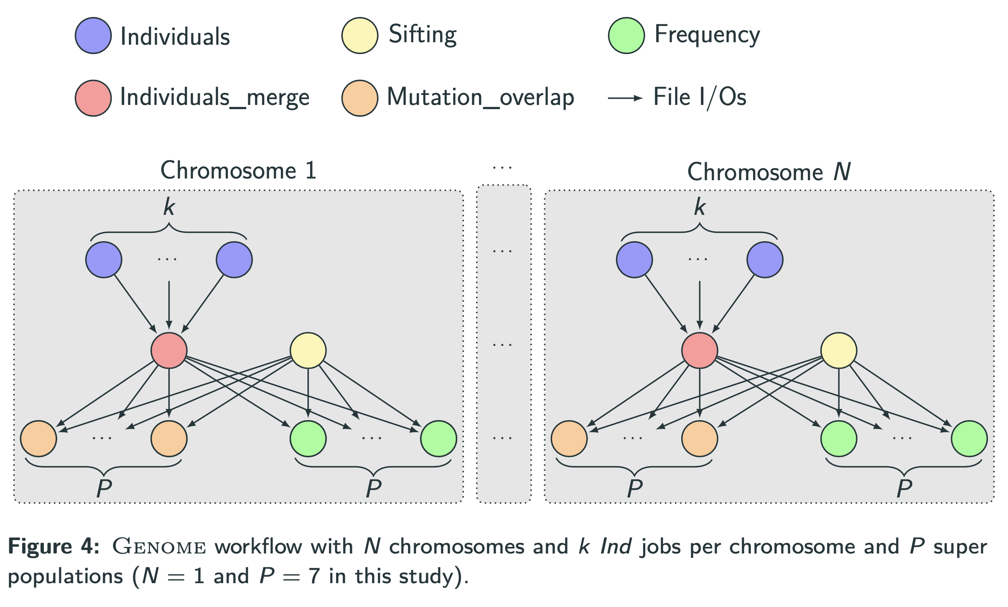
Genome

Slide 15
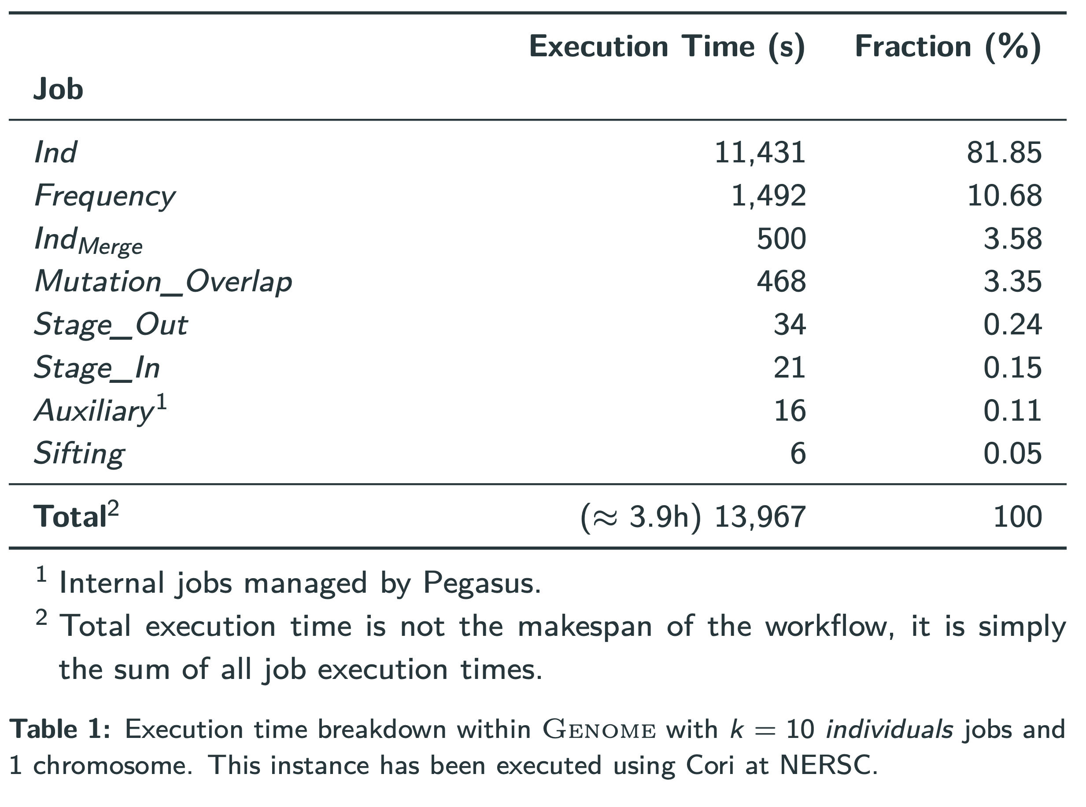
Execution time breakdown for Genome

Slide 16
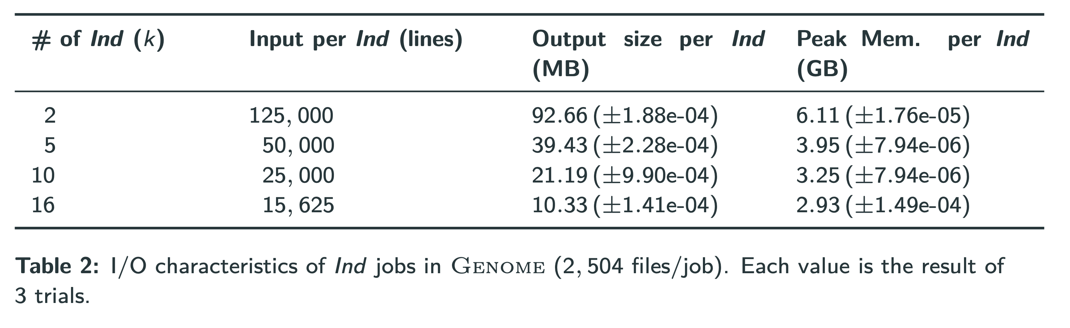
I/O characteristics for Inds jobs

Slide 17
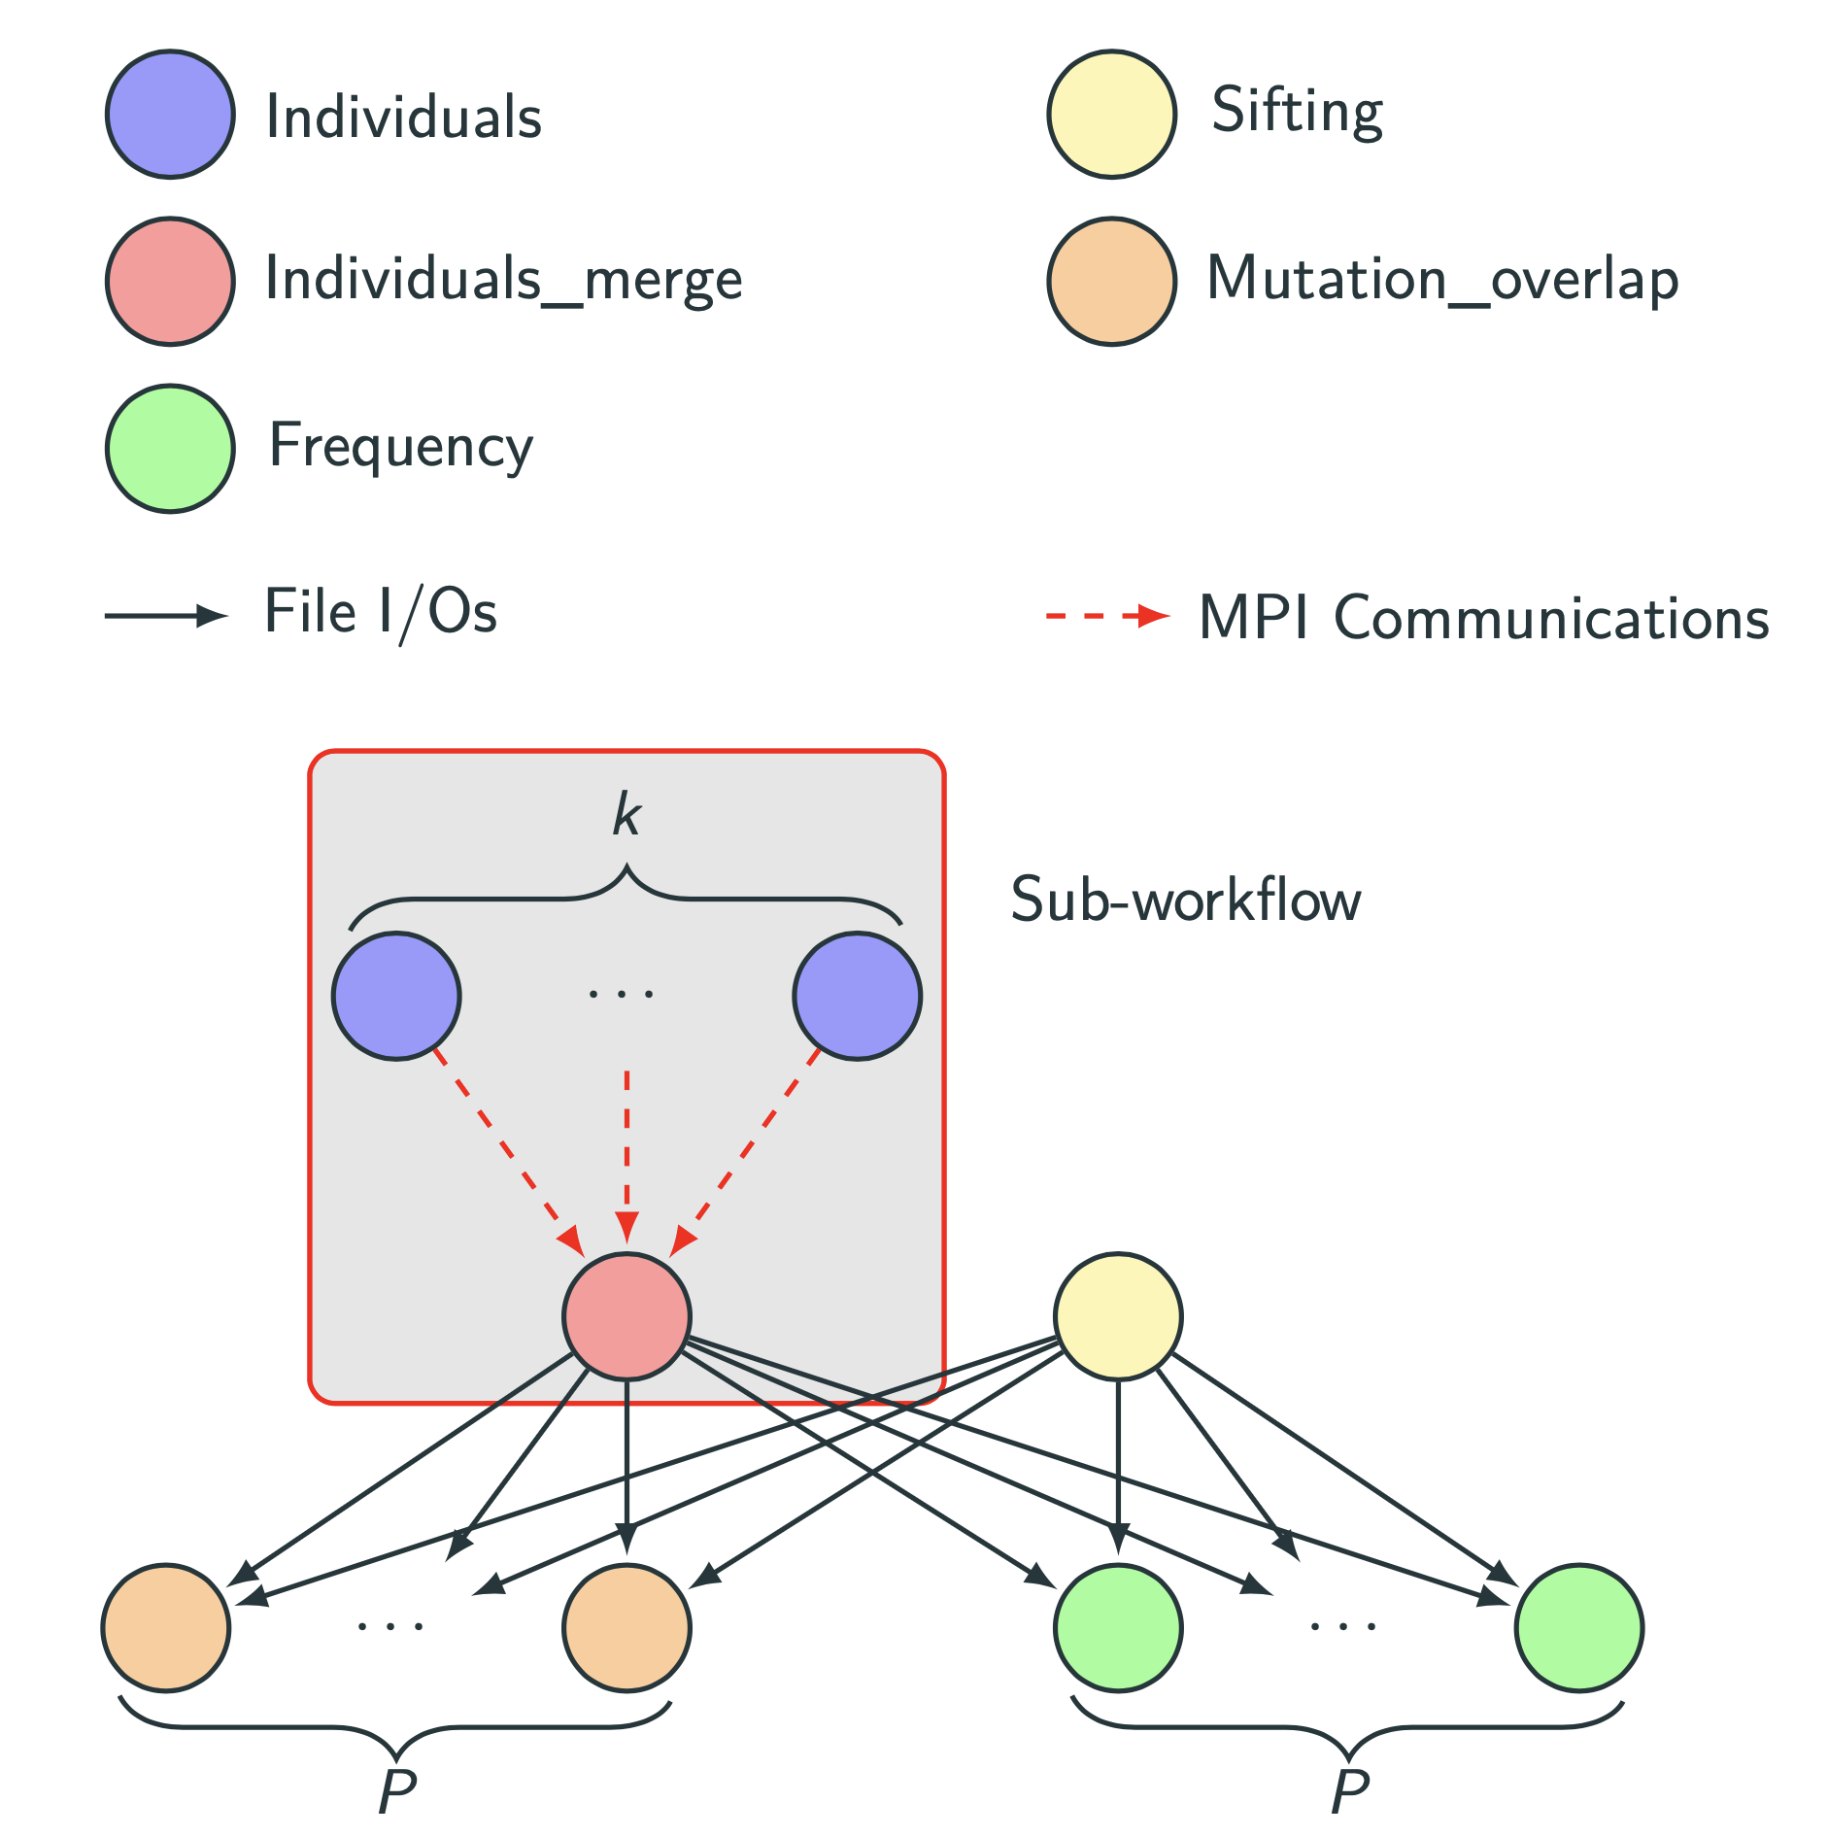
Job clustering for Genome

Slide 18
Execution scenarios
Vanilla: Baseline scenario, no job clustering and file-based communications
PMC: Leverages Pegasus-MPI-Cluster (PMC) to execute portion of the workflow (sub-workflow)
PegDecaf: Leverages Decaf (MPI communications) to execute portion of the workflow

Slide 19
Experimental Results

Slide 20
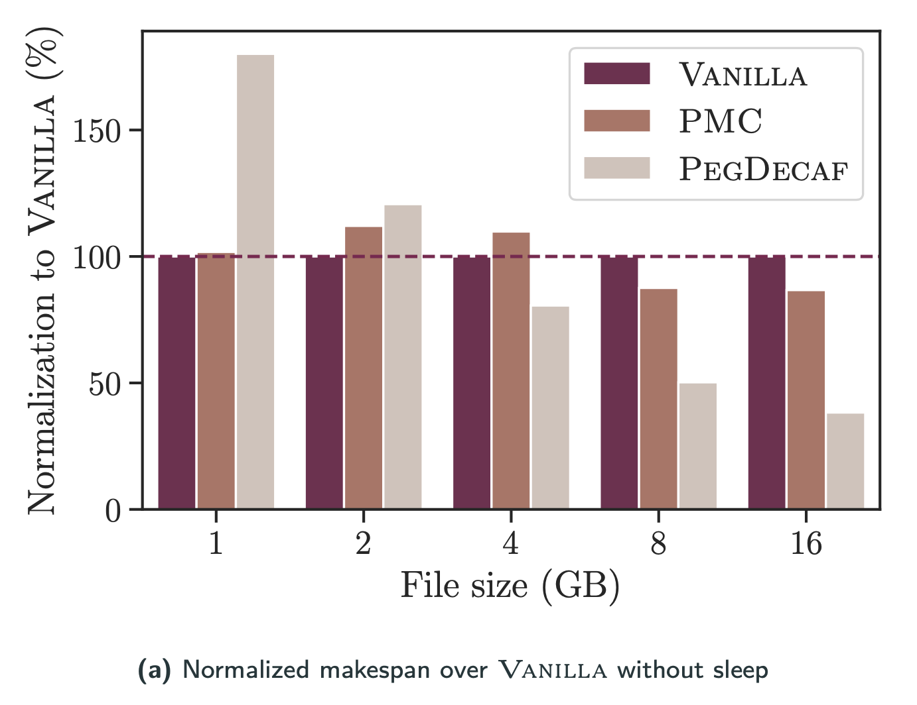
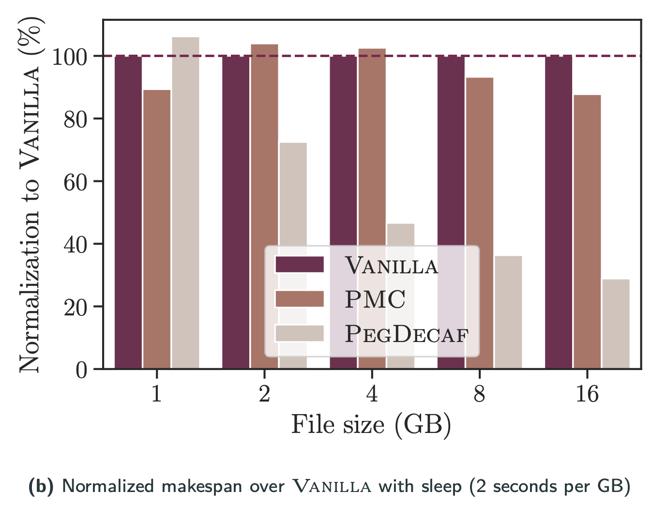
SyntheticIO

Slide 21
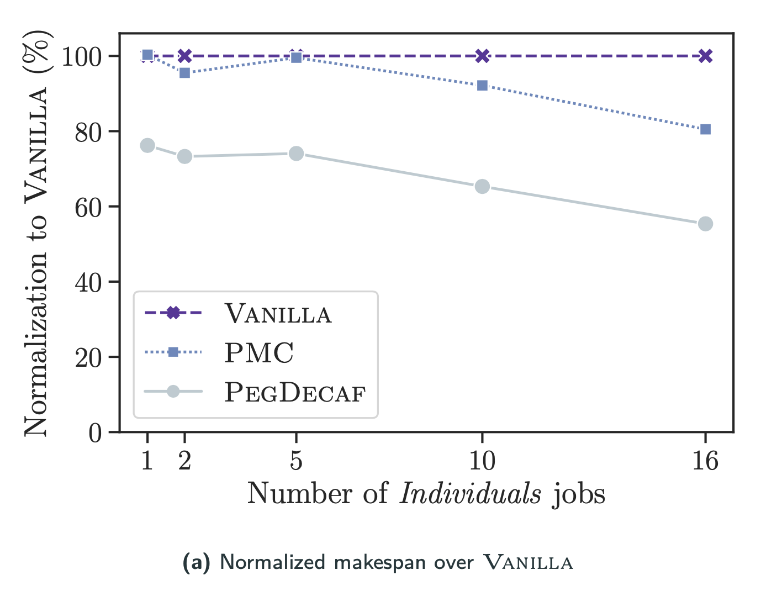
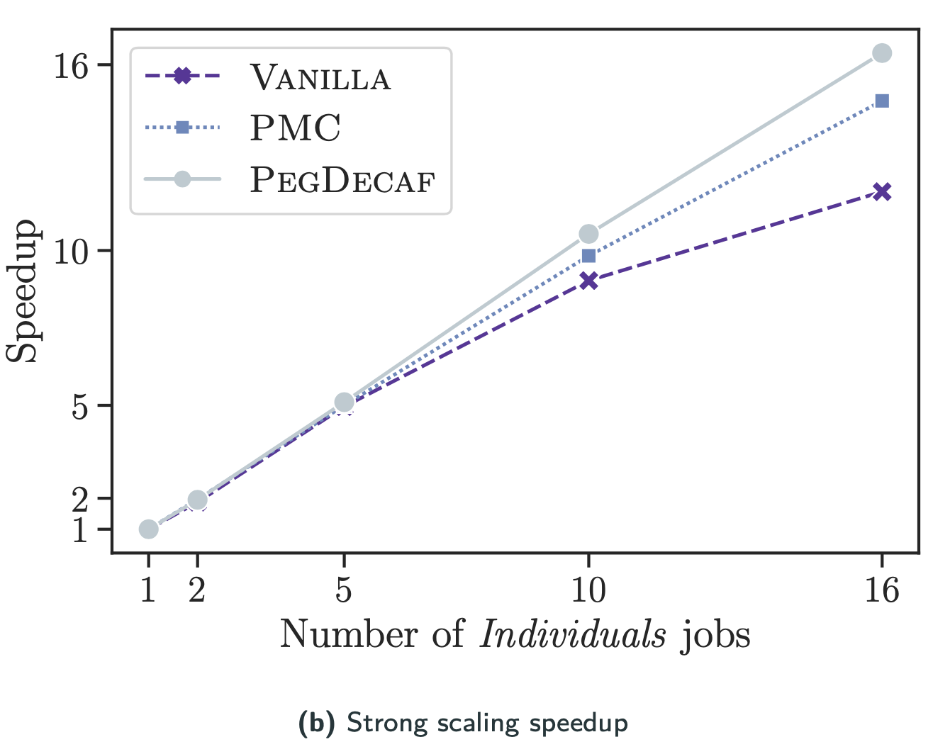

Genome – Strong scaling

Slide 22
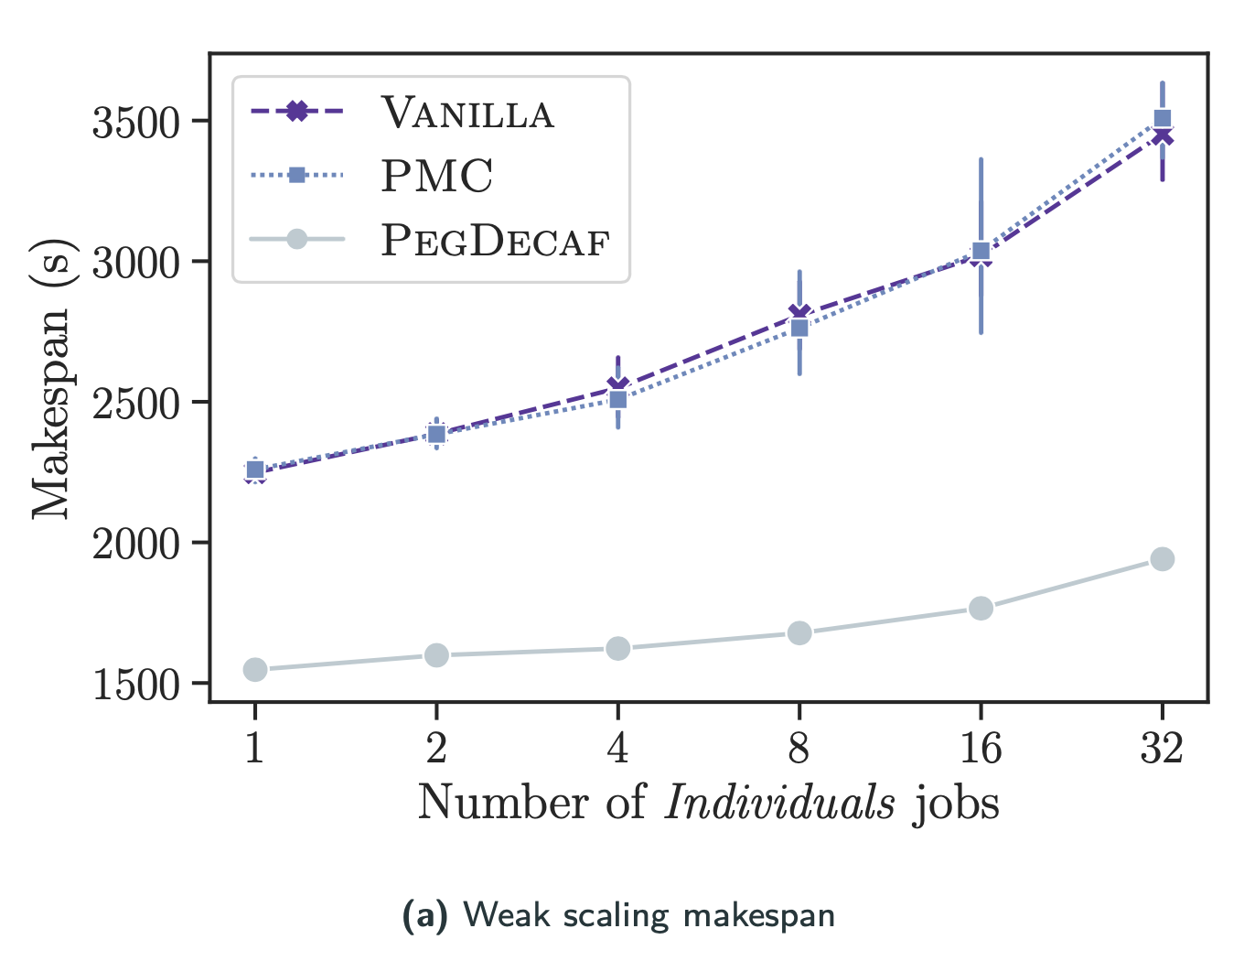
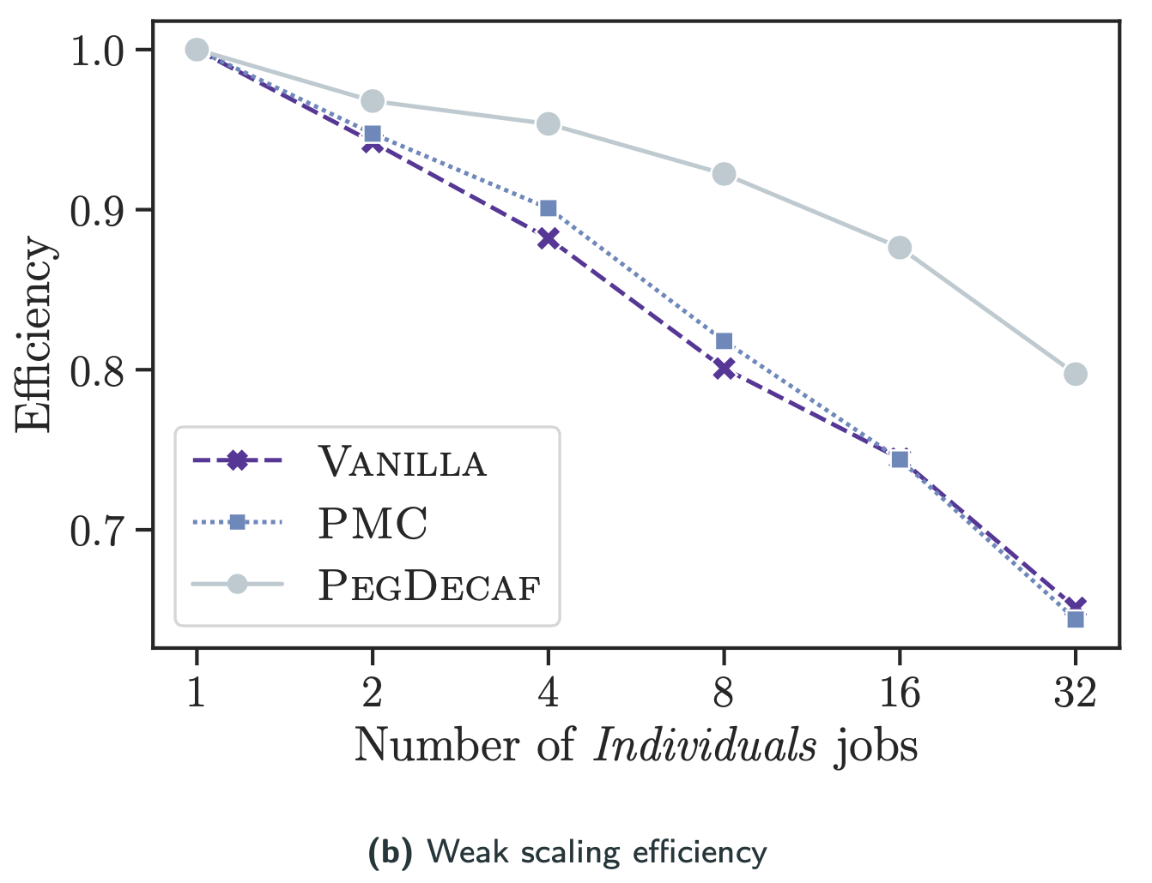

Genome – Weak scaling
Each Ind job runs on one dedicated node

Slide 23
Conclusion

Slide 24
Conclusion
Summary
Future Work
In situ communications improves the makespan of data-intensive workflows
Larger improvements when communications can be overlapped with computations
Job clustering improve wall time thanks to less submissions
But ... which jobs should be clustered together?
Release Decaf support in the next version of Pegasus
Develop heuristics to determine appropriate clusters
Extend experiments to larger workflows with in situ components (e.g., MD)

